Slide 1
ISM 6136
Data Mining Project: Group K
Title: Predictive Model for Term Deposit Subscription
Ankur Sharma
Manvith Katkuri
Nirajkumar Yogendra Singh
Varsha Disawal

Slide 2
Project Overview

Slide 3
Goal
To develop a predictive model using the Bank Marketing Dataset and assist the bank to optimize its marketing campaigns
Objective
To predict the likelihood of a client subscribing to a term deposit based on their demographics and other attributes.

Slide 4
Business Problem & Motivation

Slide 5
Bank's current marketing campaigns have suboptimal resource allocation and low conversion rates
Need to improve efficiency of campaigns by targeting right clients with personalized offers
Goal is to increase bank's subscription rate for term deposits

Slide 6
Past Work

Slide 7
We referenced the Research Paper “A Data-Driven Approach to Predict the Success of Bank Telemarketing” where 4 DM models are used: logistic regression, decision trees, neural network and support vector machine.
They used two metrics, area of the receiver operating characteristic curve (AUC) and area of the LIFT cumulative curve (ALIFT) for testing the models.
The following are the AUC metrics for the different algorithms:
Neural Network: 0.929
Logistic Regression: 0.9
Decision Tree: 0.833
SNM: 0.891

Slide 8
Opportunities in using Data Mining and Business Analytics

Slide 9
Built a Predictive model to estimate client subscription likelihood
Identified key factors influencing subscription decisions
Built a propensity score model to identify high-value leads
Optimize marketing campaigns based on model insights
Created segment-specific models for tailored campaigns

Slide 10
Data Description

Slide 11
The dataset contains real data collected from a Portuguese retail bank, from May 2008 to June 2013, in total of 52944 phone contacts.
Only 5289(11.7%) records subscribed to the term deposit
In the modeling phase, the dataset is reduced from the original set(150 features) to 17 relevant features that are used in ML models.
Input variables are age, job, marital status, education, and more.
Target variable is whether a client subscribed to term deposit or not

Slide 12
Different Machine Learning Models Used

Slide 13
Logistic Regression, Accuracy: 89%
Random Forest, Accuracy: 100%
Gradient Boosting, Accuracy: 91%
Neural Networks, Accuracy: 89%
SVM: Accuracy: 88%

Slide 14
Complete Results from Gradient Boosting

Slide 15
Gradient Boosting Metrics
Accuracy: 0.91
Precision: 0.68
Recall: 0.40
F1-score: 0.51
ROC AUC: 0.93

Slide 16
Insights

Slide 17
Most Important Features

Slide 18
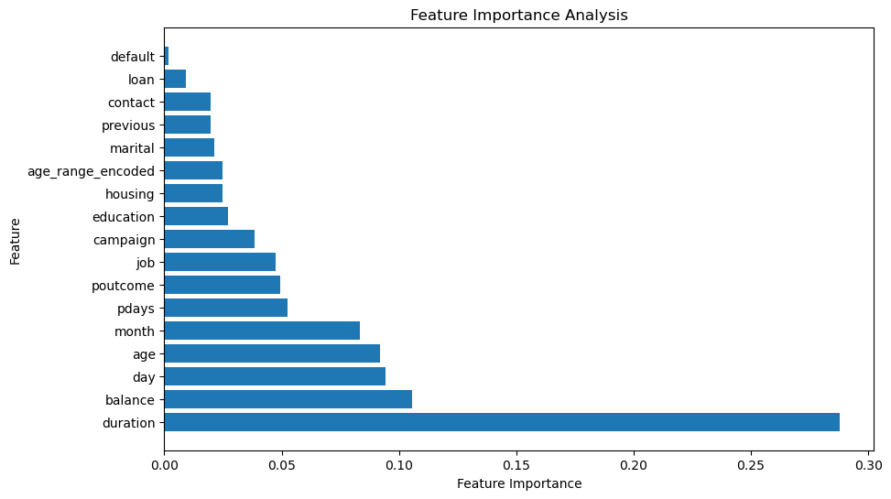

Slide 19
Identified 1,882 high value leads from the dataset
Identified the most important features such as the duration of the last call, bank balance, day and more
Best month to contact: May
Best month day to contact: 20th

Slide 20
Accuracy for Segment Specific Models Based on Call Duration

Slide 21
Accuracy for short duration (less than or equal to 100 secs): 0.98
Accuracy for medium duration (greater than 100 seconds and less than or equal to 300 seconds): 0.90
Accuracy for longer duration (greater than 300 seconds): 0.77

Slide 22
Business Recommendations

Slide 23
Prioritize High-Value Leads
Focus marketing efforts on the 1,882 high-value leads as they have the highest conversion potential.
Develop targeted campaigns and offers for this segment.
Optimize Contact Strategy
Contact high-value leads in May, 20th of a month for optimal response rates.
Personalize Messaging
Craft messaging focused on economic conditions based on importance of employment and interest rates.

Slide 24
Update Targeting Model
Continuously update model with latest data on key factors like duration and bank balance.
Track Performance
Measure marketing KPIs for high-value segment to quantify impact.
Monitor model performance to check for concept drift.

Slide 25
Happy Learning!

